Slide 1
Optimization (Max/Min)
Honors Calculus
Keeper 25

Slide 2
Strategies for Solving Max-Min Problems
If Relevant, draw and label a picture.
Translate the problems to an equation with 1 variable that represents what you are trying to maximize or minimize.
Find the derivative & use an f’ line to determine the maximum or minimum. Use that value to finish answering the problem.

Slide 3
Example 1
From a thin piece of cardboard that is 6” x 6”, square corners are cut out so that the sides can be folded up to make a box. What dimensions will yield a box of maximum volume? What is the maximum volume?

Slide 4
Example 2
A rectangular plot of land is to be fenced in using two kinds of fencing. Two opposite sides will use heavy fencing selling for $4 a foot. While the remaining two sides will use standard fencing selling for $2 a foot. What are the dimensions of the rectangular plot of greatest area that can be fenced at a cost of $8000.

Slide 5
Example 3
A soup company is constructing an open-top, square based, rectangular metal tank that will have a volume of 32 cubic feet. What dimensions yield the minimum surface area? What is the minimum surface area?

Slide 6
Example 4
Find the rectangle of maximum area which is inscribed in the closed region bound by the x-axis and y-axis and the line y = -4x + 8.

Slide 7
Example 5
A rectangle has its base on the x-axis and its upper 2 vertices on the parabola y = 12 – x². What is the largest area that the rectangle can have and what are its dimensions?

Slide 8
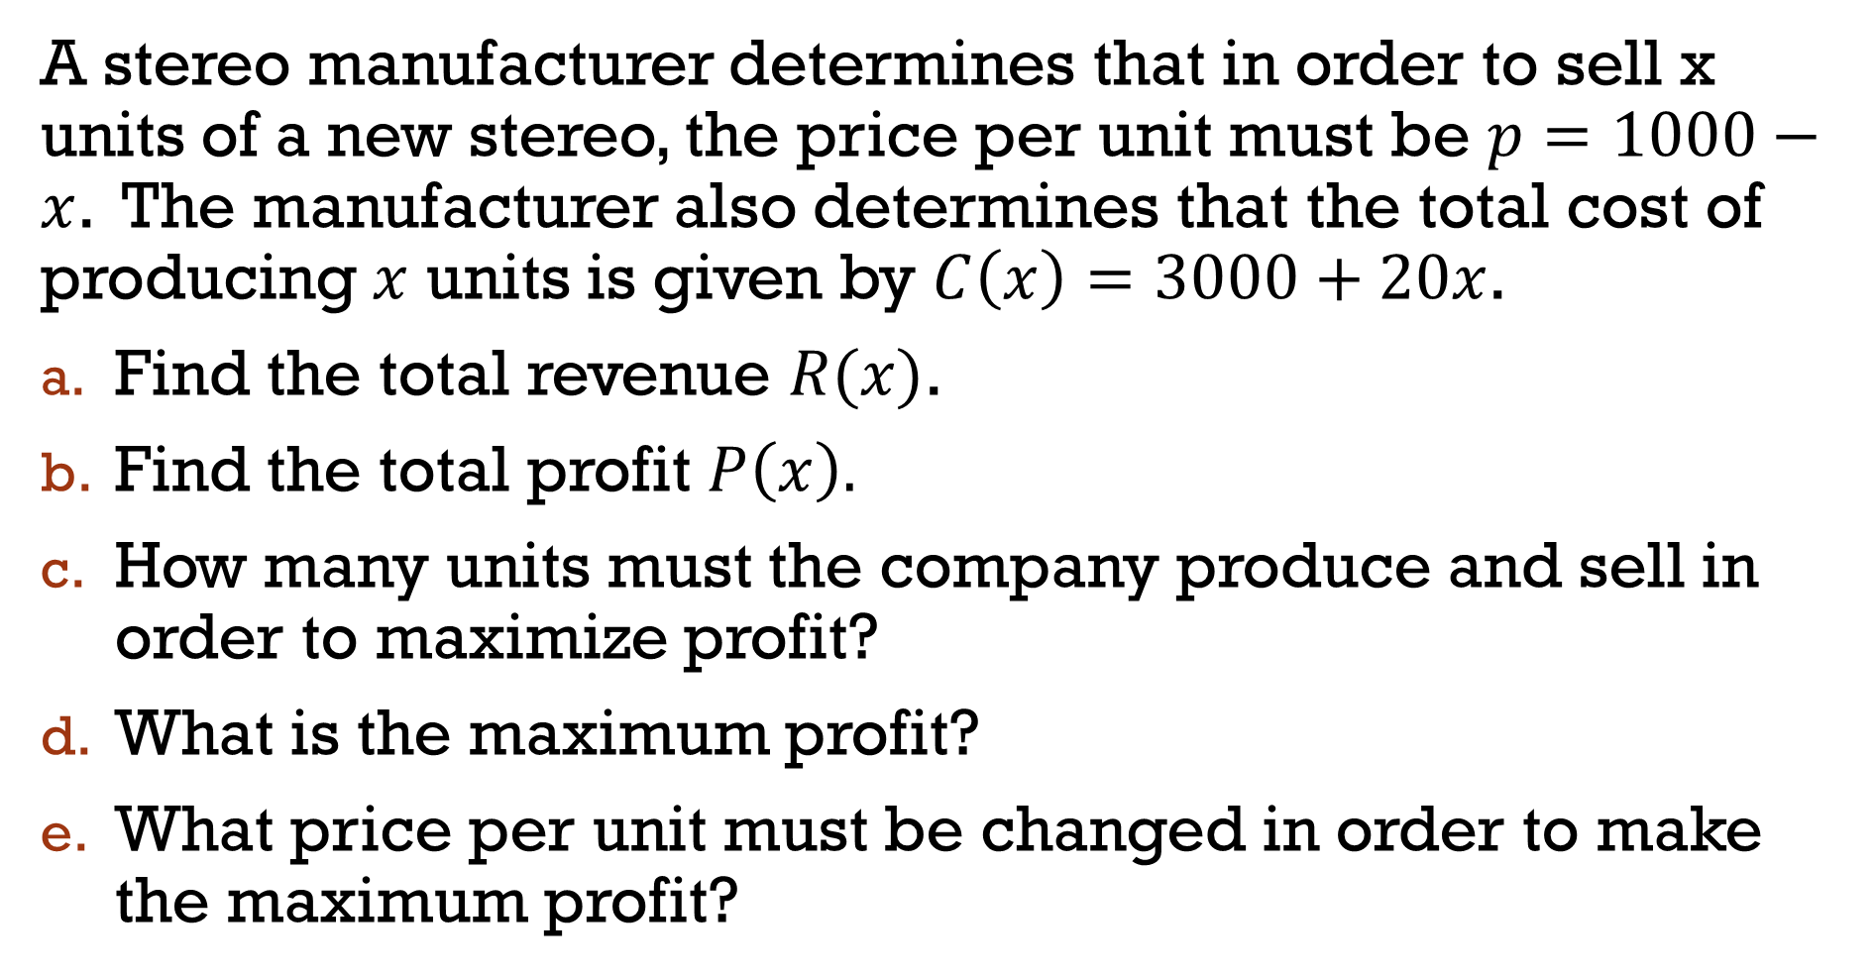
Example 6:
A stereo manufacturer determines that in order to sell x units of a new stereo, the price per unit must be $p=1000−x$. The manufacturer also determines that the total cost of producing $x$ units is given by $C\left(x\right)=3000+20x$.
Find the total revenue $R(x)$.
Find the total profit $P\left(x\right).$
How many units must the company produce and sell in order to maximize profit?
What is the maximum profit?
What price per unit must be changed in order to make the maximum profit?

Slide 9
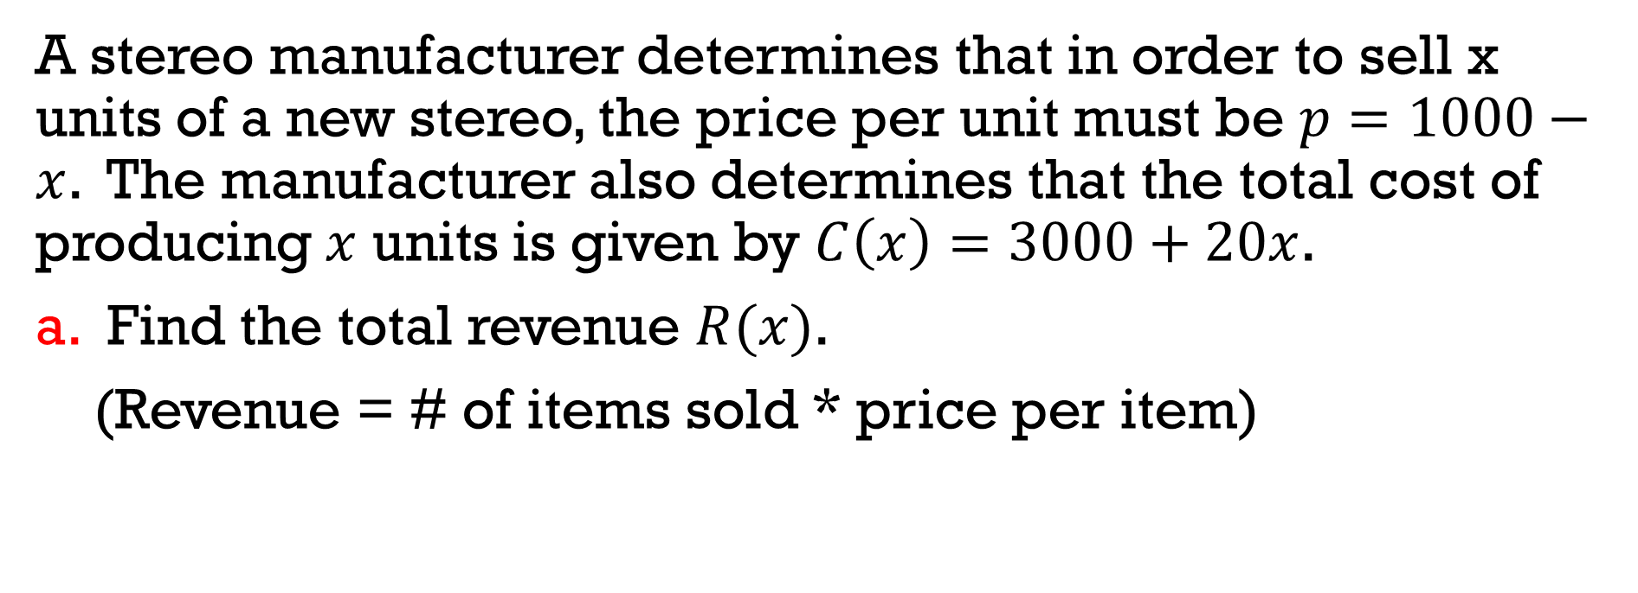
Example 6
A stereo manufacturer determines that in order to sell x units of a new stereo, the price per unit must be $p=1000−x$. The manufacturer also determines that the total cost of producing $x$ units is given by $C\left(x\right)=3000+20x$.
a. Find the total revenue $R(x)$.
(Revenue = # of items sold * price per item)

Slide 10
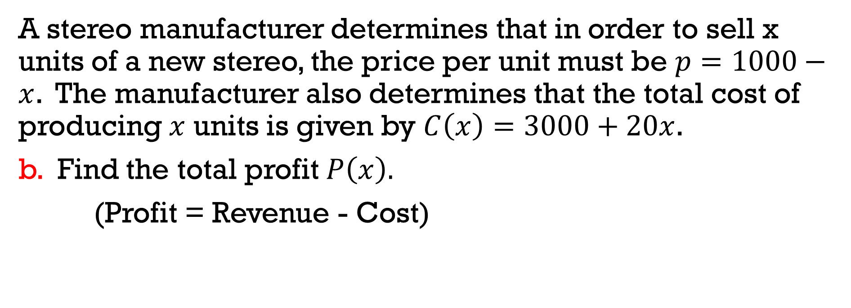
Example 6
A stereo manufacturer determines that in order to sell x units of a new stereo, the price per unit must be $p=1000−x$. The manufacturer also determines that the total cost of producing $x$ units is given by $C\left(x\right)=3000+20x$.
b. Find the total profit $P\left(x\right).$
(Profit = Revenue - Cost)

Slide 11
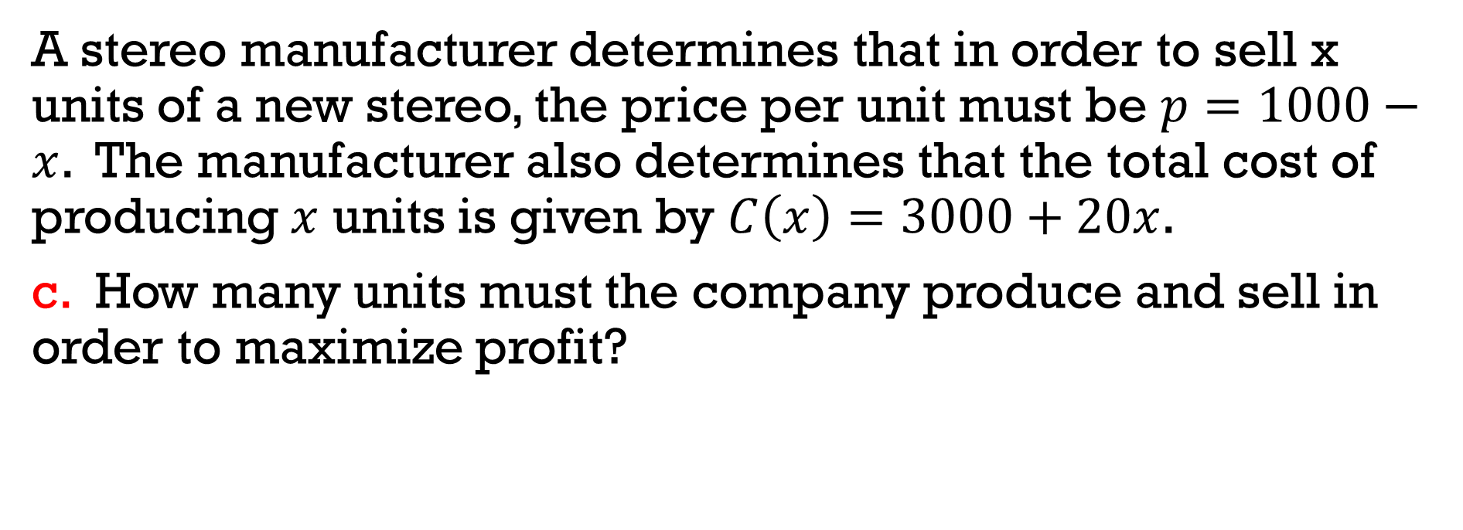
Example 6
A stereo manufacturer determines that in order to sell x units of a new stereo, the price per unit must be $p=1000−x$. The manufacturer also determines that the total cost of producing $x$ units is given by $C\left(x\right)=3000+20x$.
c. How many units must the company produce and sell in order to maximize profit?

Slide 12
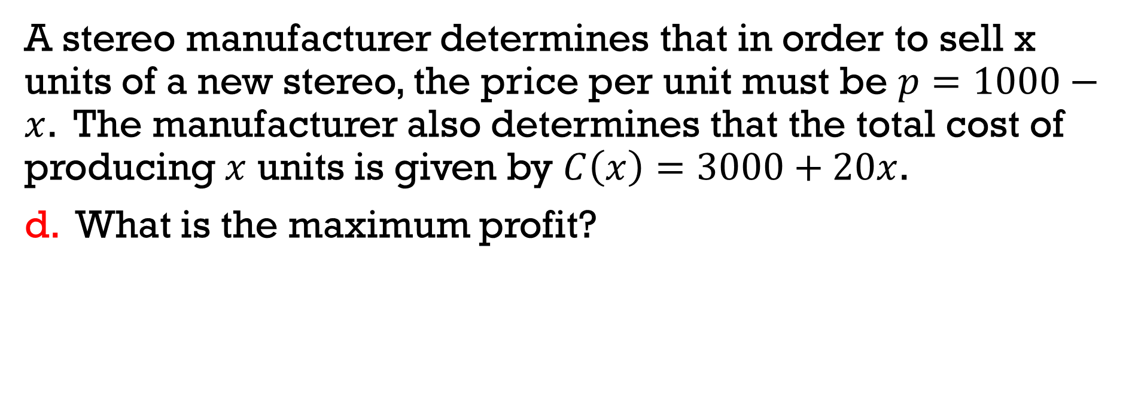
Example 6
A stereo manufacturer determines that in order to sell x units of a new stereo, the price per unit must be $p=1000−x$. The manufacturer also determines that the total cost of producing $x$ units is given by $C\left(x\right)=3000+20x$.
d. What is the maximum profit?

Slide 13
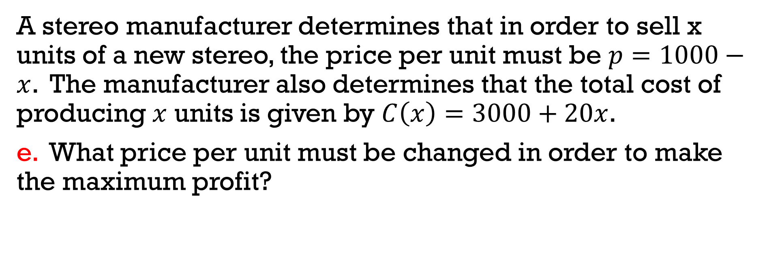
Example 6
A stereo manufacturer determines that in order to sell x units of a new stereo, the price per unit must be $p=1000−x$. The manufacturer also determines that the total cost of producing $x$ units is given by $C\left(x\right)=3000+20x$.
e. What price per unit must be changed in order to make the maximum profit?

Slide 14
Example 7:
A university is trying to determine what price to charge for football tickets. At a price of $6 per ticket, it averages 70,000 people per game. For every increase of $1, it loses 10,000 people from the average number. Every person at the game spends an average of $1.50 on concessions. What price per ticket should be charged in order to maximize revenue? How many people will attend at that price?

Slide 16
Example 2
Your friend asks you to produce a box from cardboard that is 30” x 30” with dimensions that will maximize volume. What is the maximum volume?

