Slide 1
Intermediate Value Theorem
Keeper 11
Honors Calculus

Slide 2
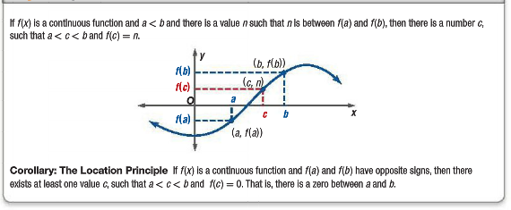
Intermediate Value Theorem

Slide 5
Example 1
Determine between which consecutive integers the real zeros are located within the interval [-4, 4] of

Slide 6
Example 2
Verify that the Intermediate Value Theorem applies to the indicated interval and find the value of $c$ guaranteed by the theorem.
$$f\left(x\right)=x^{2}+x−1, \left[0,5\right], f\left(c\right)=11$$

Slide 7
Example 3
Verify that the Intermediate Value Theorem applies to the indicated interval and find the value of $c$ guaranteed by the theorem.
$$f\left(x\right)=\frac{x^{2}+x}{x−1}, \left[\frac{5}{2}, 4\right], f\left(c\right)=6$$

Slide 8
Example
Verify that the Intermediate Value Theorem applies to the indicated interval and find the value of $c$ guaranteed by the theorem.
$$f\left(x\right)=x^{2}−6x+8, \left[0,3\right], f\left(c\right)=0$$

Slide 9
Example
Verify that the Intermediate Value Theorem applies to the indicated interval and find the value of $c$ guaranteed by the theorem.
$$f\left(x\right)=x^{3}−x^{2}+x−2, \left[0,3\right], f\left(c\right)=4$$

